Slide 1
Maven Tutorial

Slide 2
Apache Maven 3.6.3 (cecedd343002696d0abb50b32b541b8a6ba2883f)
Maven home: C:\Java\tools\apache-maven-3.6.3\bin\..
Java version: 1.8.0_172, vendor: Oracle Corporation, runtime: C:\Java\jdk1.8.0_172\jre
Default locale: zh_TW, platform encoding: MS950
OS name: "windows 10", version: "10.0", arch: "amd64", family: "windows"

Slide 3
Environment Setup
Set the environment variable
JAVA_HOME to C:\Program Files\Java\jdk1.7.0_60
Set the environment variables using system properties.
M2_HOME=C:\Program Files\Apache Software Foundation\apache-maven-3.3.1
M2=%M2_HOME%\bin
MAVEN_OPTS=-Xms256m -Xmx512m

Slide 4
POM(Project Object Model)
POM stands for Project Object Model. It is fundamental unit of work in Maven.
XML file (pom.xml)
resides in the base directory of the project
The POM contains information about the project and various configuration detail used by Maven to build the project(s).
project dependencies
plugins
goals
build profiles
project version
developers
mailing list

Slide 5
Minimal requirements for a POM
Project root
This is project root tag.
Model version
Model version should be 4.0.0.
groupId
This is an Id of project's group.
This is generally unique amongst an organization or a project.
For example, a banking group com.company.bank has all bank related projects.
artifactId
This is an Id of the project.
This is generally name of the project.
For example, consumer-banking.
Along with the groupId, the artifactId defines the artifact's location within the repository.
version
This is the version of the project.
Along with the groupId, It is used within an artifact's repository to separate versions from each other.
For example −
com.company.bank:consumer-banking:1.0

Slide 6
All POM files require the project element and three mandatory fields: groupId, artifactId, version.
Projects notation in repository is groupId:artifactId:version.

Slide 7
POM example
<project xmlns = http://maven.apache.org/POM/4.0.0
xmlns:xsi = http://www.w3.org/2001/XMLSchema-instance
xsi:schemaLocation
= "http://maven.apache.org/POM/4.0.0
http://maven.apache.org/xsd/maven-4.0.0.xsd">
<modelVersion>4.0.0</modelVersion>
<groupId>com.companyname.project-group</groupId>
<artifactId>project</artifactId>
<version>1.0</version>
</project>

Slide 8
Super POM
Super POM
All POMs inherit from a parent or default (despite explicitly defined or not).
This base POM is known as the Super POM, and contains values inherited by default.
effective POM
Maven use the effective POM (configuration from super pom plus project configuration) to execute relevant goal.

Slide 9
An easy way to look at the default configurations of the super POM
mvn help:effective-pom

Slide 10
Build Life Cycle
A Build Lifecycle is a well-defined sequence of phases, which define the order in which the goals are to be executed.
Phase | Handles | Description
prepare-resources | resource copying | Resource copying can be customized in this phase.
validate | Validating the information | Validates if the project is correct and if all necessary information is available.
compile | compilation | Source code compilation is done in this phase.
Test | Testing | Tests the compiled source code suitable for testing framework.
package | packaging | This phase creates the JAR/WAR package as mentioned in the packaging in POM.xml.
install | installation | This phase installs the package in local/remote maven repository.
Deploy | Deploying | Copies the final package to the remote repository.

Slide 11
There are always pre and post phases to register goals, which must run prior to, or after a particular phase.
When Maven starts building a project, it steps through a defined sequence of phases and executes goals, which are registered with each phase.
Maven has the following three standard lifecycles −
clean
default(or build)
site

Slide 12
A goal represents a specific task which contributes to the building and managing of a project.
It may be bound to zero or more build phases.
A goal not bound to any build phase could be executed outside of the build lifecycle by direct invocation.
The order of execution depends on the order in which the goal(s) and the build phase(s) are invoked.

Slide 13
For example, consider the command below.
mvn clean dependency:copy-dependencies package
The clean and package arguments are build phases while the dependency:copy-dependencies is a goal.
Here the clean phase will be executed first, followed by the dependency:copy-dependencies goal, and finally package phase will be executed.

Slide 14
Clean Lifecycle
When we execute mvn post-clean command, Maven invokes the clean lifecycle consisting of the following phases.
pre-clean
clean
post-clean
Maven clean goal (clean:clean) is bound to the clean phase in the clean lifecycle.
Its clean:cleangoal deletes the output of a build by deleting the build directory.
Thus, when mvn clean command executes, Maven deletes the build directory.

Slide 15
In the following example, We'll attach maven-antrun-plugin:run goal to the pre-clean, clean, and post-clean phases.
<project xmlns = http://maven.apache.org/POM/4.0.0
xmlns:xsi = http://www.w3.org/2001/XMLSchema-instance
xsi:schemaLocation =
"http://maven.apache.org/POM/4.0.0 http://maven.apache.org/xsd/maven-4.0.0.xsd">
<modelVersion>4.0.0</modelVersion>
<groupId>com.companyname.projectgroup</groupId>
<artifactId>project</artifactId>
<version>1.0</version>
<build>
<plugins>
<plugin>
<groupId>org.apache.maven.plugins</groupId>
<artifactId>maven-antrun-plugin</artifactId>
<version>1.1</version>

Slide 16
<executions> <execution>
<id>id.pre-clean</id>
<phase>pre-clean</phase>
<goals>
<goal>run</goal>
</goals>
<configuration>
<tasks>
<echo>pre-clean phase</echo>
</tasks>
</configuration>
</execution>
<execution>
<id>id.clean</id>
<phase>clean</phase>
<goals>
<goal>run</goal>
</goals>
<configuration>
<tasks>
<echo>clean phase</echo>
</tasks>
</configuration>
</execution>

Slide 17
<execution>
<id>id.post-clean</id>
<phase>post-clean</phase>
<goals>
<goal>run</goal>
</goals>
<configuration>
<tasks>
<echo>post-clean phase</echo>
</tasks>
</configuration>
</execution>
</executions>
</plugin>
</plugins>
</build>
</project>

Slide 18
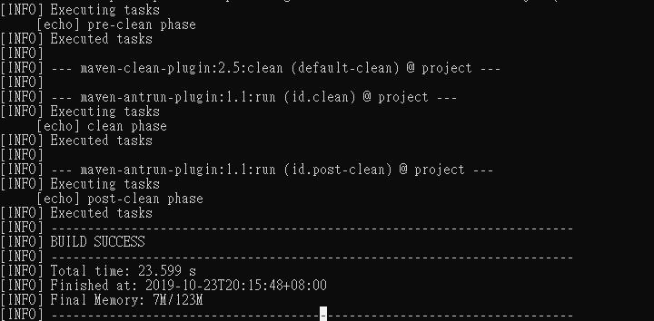
mvn post-clean

Slide 19
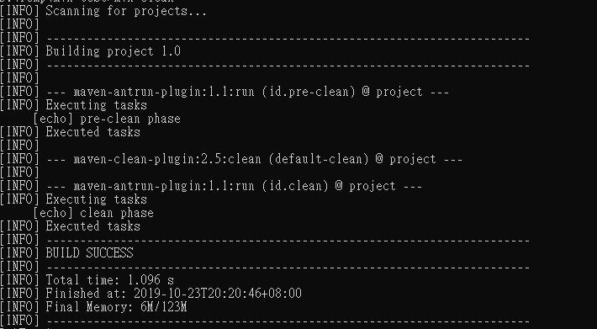
You can try tuning mvn clean command, which will display pre-clean and clean. Nothing will be executed for post-clean phase.

Slide 20
Default (or Build) Lifecycle
Sr.No. | Lifecycle Phase & Description
1 | validate Validates whether project is correct and all necessary information is available to complete the build process.
2 | initialize Initializes build state, for example set properties.
3 | generate-sources Generate any source code to be included in compilation phase.
4 | process-sources Process the source code, for example, filter any value.
5 | generate-resources Generate resources to be included in the package.
6 | process-resources Copy and process the resources into the destination directory, ready for packaging phase.

Slide 21
7 | compile Compile the source code of the project.
8 | process-classes Post-process the generated files from compilation, for example to do bytecode enhancement/optimization on Java classes.
9 | generate-test-sources Generate any test source code to be included in compilation phase.
10 | process-test-sources Process the test source code, for example, filter any values.
11 | test-compile Compile the test source code into the test destination directory.
12 | process-test-classes Process the generated files from test code file compilation.

Slide 22
13 | test Run tests using a suitable unit testing framework (Junit is one).
14 | prepare-package Perform any operations necessary to prepare a package before the actual packaging.
15 | package Take the compiled code and package it in its distributable format, such as a JAR, WAR, or EAR file.
16 | pre-integration-test Perform actions required before integration tests are executed. For example, setting up the required environment.
17 | integration-test Process and deploy the package if necessary into an environment where integration tests can be run.
18 | post-integration-test Perform actions required after integration tests have been executed. For example, cleaning up the environment.

Slide 23
19 | verify Run any check-ups to verify the package is valid and meets quality criteria.
20 | install Install the package into the local repository, which can be used as a dependency in other projects locally.
21 | deploy Copies the final package to the remote repository for sharing with other developers and projects.

Slide 24
important concepts related to Maven Lifecycles
When a phase is called via Maven command, for example mvn compile, only phases up to and including that phase will execute.
Different maven goals will be bound to different phases of Maven lifecycle depending upon the type of packaging (JAR / WAR / EAR).

Slide 25
In the following example, we will attach maven-antrun-plugin:run goal to few of the phases of Build lifecycle

Slide 26
<project xmlns = http://maven.apache.org/POM/4.0.0
xmlns:xsi = http://www.w3.org/2001/XMLSchema-instance
xsi:schemaLocation =
"http://maven.apache.org/POM/4.0.0 http://maven.apache.org/xsd/maven-4.0.0.xsd">
<modelVersion>4.0.0</modelVersion>
<groupId>com.companyname.projectgroup</groupId>
<artifactId>project</artifactId>
<version>1.0</version>
<build> <plugins> <plugin>
<groupId>org.apache.maven.plugins</groupId>
<artifactId>maven-antrun-plugin</artifactId>
<version>1.1</version>
<executions>
<execution> <id>id.validate</id>
<phase>validate</phase>
<goals> <goal>run</goal> </goals>
<configuration>
<tasks>
<echo>validate phase</echo>
</tasks>
</configuration>
</execution>
<execution>
<id>id.compile</id> <phase>compile</phase>
<goals> <goal>run</goal> </goals>
<configuration>
<tasks>
<echo>compile phase</echo>
</tasks>
</configuration> </execution>

Slide 27
<execution>
<id>id.test</id>
<phase>test</phase> <goals>
<goal>run</goal>
</goals>
<configuration>
<tasks>
<echo>test phase</echo> </tasks>
</configuration> </execution>
<execution> <id>id.package</id>
<phase>package</phase>
<goals> <goal>run</goal>
</goals> <configuration>
<tasks> <echo>package phase</echo> </tasks>
</configuration> </execution>
<execution> <id>id.deploy</id>
<phase>deploy</phase>
<goals> <goal>run</goal>
</goals> <configuration>
<tasks> <echo>deploy phase</echo>
</tasks> </configuration>
</execution> </executions> </plugin>
</plugins>
</build>
</project>

Slide 28
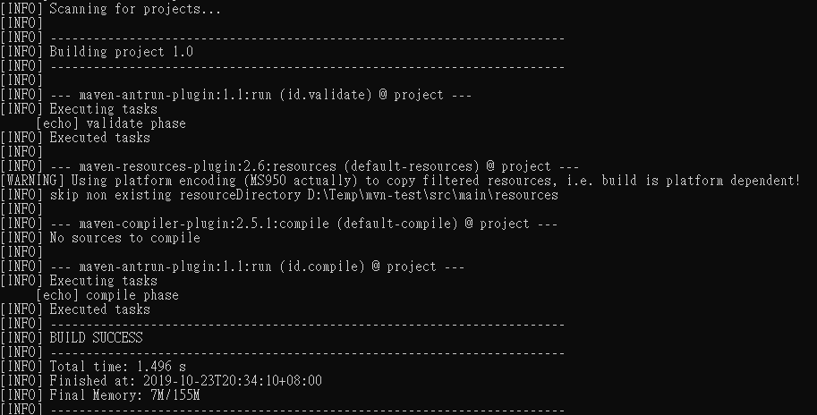

Slide 29
Site Lifecycle
Maven Site plugin is generally used to create fresh documentation to create reports, deploy site, etc. It has the following phases −
pre-site
site
post-site
site-deploy

Slide 30
Maven - Build Profiles
A Build profile is a set of configuration values, which can be used to set or override default values of Maven build.
Using a build profile, you can customize build for different environments such as Production v/s Development environments.
Profiles are specified in pom.xml file using its activeProfiles/profiles elements and are triggered in variety of ways.

Slide 31
Types of Build Profile
Type | Where it is defined
Per Project | Defined in the project POM file, pom.xml
Per User | Defined in Maven settings xml file (%USER_HOME%/.m2/settings.xml)
Global | Defined in Maven global settings xml file (%M2_HOME%/conf/settings.xml)

Slide 32
Profile Activation
Explicitly using command console input.
Through maven settings.
Based on environment variables (User/System variables).
OS Settings (for example, Windows family).
Present/missing files.

Slide 33
Explicit Profile Activation
execute the following mvn command. Pass the profile name as argument using -P option.
C:\MVN\project>mvn test -Ptest

Slide 34
Profile Activation via Maven Settings
Open Maven settings.xml file available in %USER_HOME%/.m2
<settings xmlns = "http://maven.apache.org/POM/4.0.0"
xmlns:xsi = "http://www.w3.org/2001/XMLSchema-instance"
xsi:schemaLocation="http://maven.apache.org/POM/4.0.0
http://maven.apache.org/xsd/settings-1.0.0.xsd">
<activeProfiles>
<activeProfile>test</activeProfile>
</activeProfiles>
</settings>

Slide 35
Profile Activation via Environment Variables
update the test profile mentioned in pom.xml
The test profile will trigger when the system property "env" is specified with the value "test". Create an environment variable "env" and set its value as "test".
<profile>
<id>test</id>
<activation>
<property>
<name>env</name>
<value>test</value>
</property>
</activation>
</profile>

Slide 36
Profile Activation via Operating System
Activation element to include os detail as shown below. This test profile will trigger when the system is windows XP.
<profile>
<id>test</id>
<activation>
<os>
<name>Windows XP</name>
<family>Windows</family>
<arch>x86</arch>
<version>5.1.2600</version>
</os>
</activation>
</profile>

Slide 37
Profile Activation via Present/Missing File
The test profile will trigger when target/generated-sources/axistools/wsdl2java/com/companyname/group is missing.
<profile>
<id>test</id>
<activation>
<file>
<missing>target/generated-sources/axistools/wsdl2java/com/companyname/group</missing>
</file>
</activation>
</profile>

Slide 38
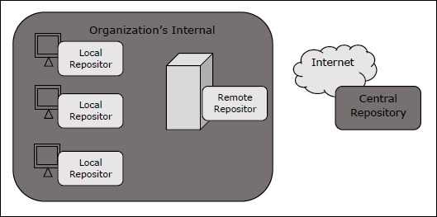
Maven - Repositories
a repository is a directory where all the project jars, library jar, plugins or any other project specific artifacts are stored and can be used by Maven easily.
Maven repository are of three types.
local
central
remote

Slide 39
Local Repository
Maven local repository is a folder location on your machine.
It gets created when you run any maven command for the first time.
Maven local repository keeps your project's all dependencies (library jars, plugin jars etc.).
When you run a Maven build, then Maven automatically downloads all the dependency jars into the local repository.
by default, %USER_HOME% directory.

Slide 40
To override the default location, mention another path in Maven settings.xml file available at %M2_HOME%\conf directory.
<settings xmlns = http://maven.apache.org/SETTINGS/1.0.0
xmlns:xsi = http://www.w3.org/2001/XMLSchema-instance
xsi:schemaLocation = "http://maven.apache.org/SETTINGS/1.0.0
http://maven.apache.org/xsd/settings-1.0.0.xsd">
<localRepository>C:/MyLocalRepository</localRepository>
</settings>

Slide 41
Central Repository
Maven central repository is repository provided by Maven community.
When Maven does not find any dependency in local repository, it starts searching in central repository
− https://repo1.maven.org/maven2/
To browse the content of central maven repository,
− https://search.maven.org/#browse

Slide 42
Remote Repository
Remote Repository, which is developer's own custom repository containing required libraries or other project jars.
Maven will download dependency (if not available in central repository) from Remote Repositories mentioned in the pom.xml.
<project xmlns = "http://maven.apache.org/POM/4.0.0"
xmlns:xsi = http://www.w3.org/2001/XMLSchema-instance
xsi:schemaLocation = "http://maven.apache.org/POM/4.0.0
http://maven.apache.org/xsd/maven-4.0.0.xsd">
<modelVersion>4.0.0</modelVersion>
<groupId>com.companyname.projectgroup</groupId>
<artifactId>project</artifactId>
<version>1.0</version>
<repositories>
<repository>
<id>companyname.lib1</id>
<url>http://download.companyname.org/maven2/lib1</url>
</repository>
</repositories>
</project>

Slide 43
Maven Dependency Search Sequence
1 − Search dependency in local repository
2 − Search dependency in central repository
3 − Search dependency in remote repository If a remote repository has been mentioned

Slide 44
Maven - Plugins
Maven is actually a plugin execution framework where every task is actually done by plugins.
A plugin generally provides a set of goals, which can be executed using the following syntax −
mvn [plugin-name]:[goal-name]
ex: mvn compiler:compile

Slide 45
Plugin Types
Sr.No. | Type & Description
1 | Build plugins They execute during the build process and should be configured in the <build/> element of pom.xml.
2 | Reporting plugins They execute during the site generation process and they should be configured in the <reporting/> element of the pom.xml.

Slide 46
common plugins
Sr.No. | Plugin & Description
1 | clean Cleans up target after the build. Deletes the target directory.
2 | compiler Compiles Java source files.
3 | surefire Runs the JUnit unit tests. Creates test reports.
4 | jar Builds a JAR file from the current project.
5 | war Builds a WAR file from the current project.
6 | javadoc Generates Javadoc for the project.
7 | antrun Runs a set of ant tasks from any phase mentioned of the build.

Slide 47
Example
We've used maven-antrun-plugin extensively in our examples to print data on console.
<project xmlns = "http://maven.apache.org/POM/4.0.0"
xmlns:xsi = "http://www.w3.org/2001/XMLSchema-instance"
xsi:schemaLocation = "http://maven.apache.org/POM/4.0.0
http://maven.apache.org/xsd/maven-4.0.0.xsd">
<modelVersion>4.0.0</modelVersion>
<groupId>com.companyname.projectgroup</groupId>
<artifactId>project</artifactId>
<version>1.0</version>
<build>
<plugins>
<plugin>
<groupId>org.apache.maven.plugins</groupId>
<artifactId>maven-antrun-plugin</artifactId>
<version>1.1</version>
<executions>
<execution>
<id>id.clean</id>
<phase>clean</phase>
<goals>
<goal>run</goal>
</goals>
<configuration>
<tasks>
<echo>clean phase</echo>
</tasks>
</configuration>
</execution>
</executions>
</plugin>
</plugins>
</build>
</project>

Slide 48
The above example illustrates the following key concepts −
Plugins are specified in pom.xml using plugins element.
Each plugin can have multiple goals.
You can define phase from where plugin should starts its processing using its phase element.
You can configure tasks to be executed by binding them to goals of plugin.
Maven will then download the plugin if not available in local repository and start its processing.

Slide 49
Maven - Creating Project
Maven uses archetype plugins to create projects.
mvn archetype:generate
-DgroupId = com.companyname.bank
-DartifactId = consumerBanking
-DarchetypeArtifactId = maven-archetype-quickstart
-DinteractiveMode = false

Slide 50
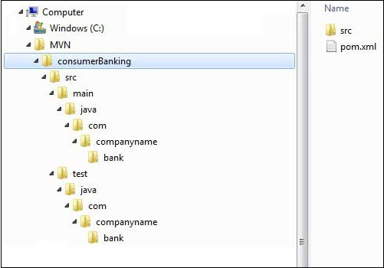
Maven uses a standard directory layout as shown below

Slide 51
Sr.No. | Folder Structure & Description
1 | consumerBanking contains src folder and pom.xml
2 | src/main/java contains java code files under the package structure (com/companyName/bank).
3 | src/test/java contains test java code files under the package structure (com/companyName/bank).
4 | src/main/resources it contains images/properties files (In above example, we need to create this structure manually).

Slide 52
mvn clean package
You've built your project and created final jar file, following are the key learning concepts −
We give maven two goals, first to clean the target directory (clean) and then package the project build output as jar (package).
Packaged jar is available in consumerBanking\target folder as consumerBanking-1.0-SNAPSHOT.jar.
Test reports are available in consumerBanking\target\surefire-reports folder.
Maven compiles the source code file(s) and then tests the source code file(s).
Then Maven runs the test cases.
Finally, Maven creates the package.

Slide 53
Maven - External Dependencies
while you are having your own library, which may not be available in any repository for maven to download from.
<project xmlns = "http://maven.apache.org/POM/4.0.0"
xmlns:xsi = "http://www.w3.org/2001/XMLSchema-instance"
xsi:schemaLocation="http://maven.apache.org/POM/4.0.0
http://maven.apache.org/maven-v4_0_0.xsd">
<modelVersion>4.0.0</modelVersion>
<groupId>com.companyname.bank</groupId>
<artifactId>consumerBanking</artifactId>
<packaging>jar</packaging>
<version>1.0-SNAPSHOT</version>
<name>consumerBanking</name>
<url>http://maven.apache.org</url>
<dependencies>
<dependency>
<groupId>ldapjdk</groupId>
<artifactId>ldapjdk</artifactId>
<scope>system</scope>
<version>1.0</version>
<systemPath>${basedir}\src\lib\ldapjdk.jar</systemPath>
</dependency>
</dependencies>
</project>

Slide 54
External dependencies (library jar location) can be configured in pom.xml in same way as other dependencies.
Specify groupId same as the name of the library.
Specify artifactId same as the name of the library.
Specify scope as system.
Specify system path relative to the project location.

Slide 55
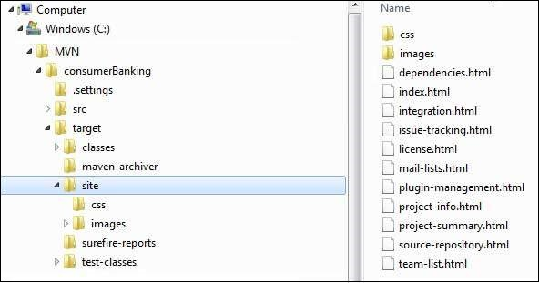
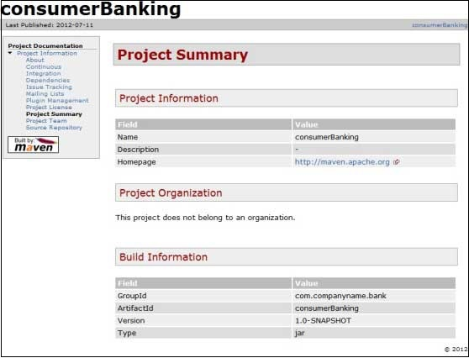
Project Documents
mvn site
build project documentation
Maven has created a site within the target directory.

Slide 56
maven-site plugins 3.3 java.lang.ClassNotFoundException: org.apache.maven.doxia.siterenderer.DocumentContent
This is caused by maven-project-info-reports-plugin updated to 3.0.0, and rely on doxia-site-renderer 1.8 (and have org.apache.maven.doxia.siterenderer.DocumentContent this class), but maven-site-plugin:3.3 rely on doxia-site-renderer:1.4 (and do not have org.apache.maven.doxia.siterenderer.DocumentContent)
Solution: Do not use the default maven-site-plugin:3.3 plugin, upgrade it to the latest version, for example, 3.7.1
<build>
<plugins>
<plugin>
<groupId>org.apache.maven.plugins</groupId>
<artifactId>maven-site-plugin</artifactId>
<version>3.7.1</version>
</plugin>
</plugins>
</build>

Slide 57
Maven creates the documentation using a documentation-processing engine called Doxia which reads multiple source formats into a common document model.
To write documentation for your project, you can write your content in a following few commonly used formats which are parsed by Doxia.
Format Name | Description | Reference
XDoc | A Maven 1.x documentation format | https://jakarta.apache.org/site
FML | Used for FAQ documents | https://maven.apache.org

Slide 58
Maven - Project Templates
Maven provides users, a very large list of different types of project templates (614 in numbers) using the concept of Archetype.
mvn archetype:generate
Archetype is a Maven plugin whose task is to create a project structure as per its template.
Maven will start processing and will ask to choose the required archetype.
7: internal -> org.apache.maven.archetypes:maven-archetype-quickstart (An archetype which contains a sample Maven project.)
10: internal -> org.apache.maven.archetypes:maven-archetype-webapp (An archetype which contains a sample Maven Webapp project.)

Slide 59
Different Archetypes
Sr.No. | Archetype ArtifactIds & Description
1 | maven-archetype-archetype An archetype, which contains a sample archetype.
2 | maven-archetype-j2ee-simple An archetype, which contains a simplified sample J2EE application.
3 | maven-archetype-mojo An archetype, which contains a sample a sample Maven plugin.
4 | maven-archetype-plugin An archetype, which contains a sample Maven plugin.
5 | maven-archetype-plugin-site An archetype, which contains a sample Maven plugin site.
6 | maven-archetype-portlet An archetype, which contains a sample JSR-268 Portlet.
7 | maven-archetype-quickstart An archetype, which contains a sample Maven project.
8 | maven-archetype-simple An archetype, which contains a simple Maven project.
9 | maven-archetype-site An archetype, which contains a sample Maven site to demonstrates some of the supported document types like APT, XDoc, and FML and demonstrates how to i18n your site.
10 | maven-archetype-site-simple An archetype, which contains a sample Maven site.
11 | maven-archetype-webapp An archetype, which contains a sample Maven Webapp project.

Slide 60
Maven - Snapshots
SNAPSHOT is a special version that indicates a current development copy.
Unlike regular versions, Maven checks for a new SNAPSHOT version in a remote repository for every build.
Snapshot vs Version
data-service:1.0, Maven will never try to download a newer 1.0 available in repository. To download the updated code, data-service version is be upgraded to 1.1.
data-service:1.0-SNAPSHOT, Maven will automatically fetch the latest SNAPSHOT every time.

Slide 61
<project xmlns = "http://maven.apache.org/POM/4.0.0"
xmlns:xsi = "http://www.w3.org/2001/XMLSchema-instance"
xsi:schemaLocation = "http://maven.apache.org/POM/4.0.0
http://maven.apache.org/xsd/maven-4.0.0.xsd">
<modelVersion>4.0.0</modelVersion>
<groupId>app-ui</groupId>
<artifactId>app-ui</artifactId>
<version>1.0</version>
<packaging>jar</packaging>
<name>health</name>
<url>http://maven.apache.org</url>
<dependencies>
<dependency>
<groupId>data-service</groupId>
<artifactId>data-service</artifactId>
<version>1.0-SNAPSHOT</version>
<scope>test</scope>
</dependency>
</dependencies>
</project>
<project xmlns = "http://maven.apache.org/POM/4.0.0"
xmlns:xsi = "http://www.w3.org/2001/XMLSchema-instance"
xsi:schemaLocation = "http://maven.apache.org/POM/4.0.0
http://maven.apache.org/xsd/maven-4.0.0.xsd">
<modelVersion>4.0.0</modelVersion>
<groupId>data-service</groupId>
<artifactId>data-service</artifactId>
<version>1.0-SNAPSHOT</version>
<packaging>jar</packaging>
<name>health</name>
<url>http://maven.apache.org</url>
<properties>
<project.build.sourceEncoding>UTF-8</project.build.sourceEncoding>
</properties>
</project>

Slide 62
you can force maven to download latest snapshot build using -U switch to any maven command.
mvn clean package -U

Slide 63
Maven - Build Automation
Build Automation defines the scenario where dependent project(s) build process gets started once the project build is successfully completed, in order to ensure that dependent project(s) is/are stable.

Slide 64
Example
Consider a team is developing a project bus-core-api on which two other projects app-web-ui and app-desktop-ui are dependent.
app-web-ui and app-desktop-ui projects require that their build process should kick off whenever bus-core-api project changes.
two ways
Add a post-build goal in bus-core-api pom to kick-off app-web-ui and app-desktop-ui builds.
Use a Continuous Integration (CI) Server like Hudson to manage build automation automatically.

Slide 65
solution 1. Update bus-core-api project pom.xml.
<project xmlns = "http://maven.apache.org/POM/4.0.0"
xmlns:xsi = "http://www.w3.org/2001/XMLSchema-instance"
xsi:schemaLocation = "http://maven.apache.org/POM/4.0.0
http://maven.apache.org/xsd/maven-4.0.0.xsd">
<modelVersion>4.0.0</modelVersion>
<groupId>bus-core-api</groupId>
<artifactId>bus-core-api</artifactId>
<version>1.0-SNAPSHOT</version>
<packaging>jar</packaging>
<build>
<plugins>
<plugin>
<artifactId>maven-invoker-plugin</artifactId>
<version>1.6</version>
<configuration>
<debug>true</debug>
<pomIncludes>
<pomInclude>app-web-ui/pom.xml</pomInclude>
<pomInclude>app-desktop-ui/pom.xml</pomInclude>
</pomIncludes>
</configuration>
<executions>
<execution>
<id>build</id>
<goals>
<goal>run</goal>
</goals>
</execution>
</executions>
</plugin>
</plugins>
<build>
</project>

Slide 66
Maven - Manage Dependencies
Transitive Dependencies Discovery
We only need to define direct dependency in each project pom.
Maven helps to discover all the libraries required by reading project files (pom.xml) of dependencies, figuring out their dependencies and so on.

Slide 67
when there are duplicate libraries
Sr.No. | Feature & Description
1 | Dependency mediation Determines what version of a dependency is to be used when multiple versions of an artifact are encountered. If two dependency versions are at the same depth in the dependency tree, the first declared dependency will be used.
2 | Dependency management Directly specify the versions of artifacts to be used when they are encountered in transitive dependencies.
3 | Dependency scope Includes dependencies as per the current stage of the build.
4 | Excluded dependencies Any transitive dependency can be excluded using "exclusion" element. As example, A depends upon B and B depends upon C, then A can mark C as excluded.
5 | Optional dependencies Any transitive dependency can be marked as optional using "optional" element. As example, A depends upon B and B depends upon C. Now B marked C as optional. Then A will not use C.

Slide 68
Dependency Scope
Sr.No. | Scope & Description
1 | compile This scope indicates that dependency is available in classpath of project. It is default scope.
2 | provided This scope indicates that dependency is to be provided by JDK or web-Server/Container at runtime.
3 | runtime This scope indicates that dependency is not required for compilation, but is required during execution.
4 | test This scope indicates that the dependency is only available for the test compilation and execution phases.
5 | system This scope indicates that you have to provide the system path.
6 | import This scope is only used when dependency is of type pom. This scope indicates that the specified POM should be replaced with the dependencies in that POM's <dependencyManagement> section.

Slide 69
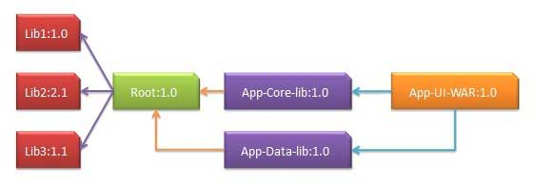
Dependency Management
App-UI-WAR depends upon App-Core-lib and App-Data-lib.
Root is parent of App-Core-lib and App-Data-lib.
Root defines Lib1, lib2, Lib3 as dependencies in its dependency section.

Slide 70
App-UI-WAR
<project xmlns = "http://maven.apache.org/POM/4.0.0"
xmlns:xsi = "http://www.w3.org/2001/XMLSchema-instance"
xsi:schemaLocation = "http://maven.apache.org/POM/4.0.0
http://maven.apache.org/xsd/maven-4.0.0.xsd">
<modelVersion>4.0.0</modelVersion>
<groupId>com.companyname.groupname</groupId>
<artifactId>App-UI-WAR</artifactId>
<version>1.0</version>
<packaging>war</packaging>
<dependencies>
<dependency>
<groupId>com.companyname.groupname</groupId>
<artifactId>App-Core-lib</artifactId>
<version>1.0</version>
</dependency>
<dependency>
<groupId>com.companyname.groupname</groupId>
<artifactId>App-Data-lib</artifactId>
<version>1.0</version>
</dependency>
</dependencies>
</project>

Slide 71
App-Core-lib
<project xmlns = "http://maven.apache.org/POM/4.0.0"
xmlns:xsi = "http://www.w3.org/2001/XMLSchema-instance"
xsi:schemaLocation = "http://maven.apache.org/POM/4.0.0
http://maven.apache.org/xsd/maven-4.0.0.xsd">
<parent>
<artifactId>Root</artifactId>
<groupId>com.companyname.groupname</groupId>
<version>1.0</version>
<relativePath>pom-parent.xml</relativePath>
</parent>
<modelVersion>4.0.0</modelVersion>
<groupId>com.companyname.groupname</groupId>
<artifactId>App-Core-lib</artifactId>
<version>1.0</version>
<packaging>jar</packaging>
</project>

Slide 72
App-Data-lib
<project xmlns = "http://maven.apache.org/POM/4.0.0"
xmlns:xsi = "http://www.w3.org/2001/XMLSchema-instance"
xsi:schemaLocation = "http://maven.apache.org/POM/4.0.0
http://maven.apache.org/xsd/maven-4.0.0.xsd">
<parent>
<artifactId>Root</artifactId>
<groupId>com.companyname.groupname</groupId>
<version>1.0</version>
<relativePath>pom-parent.xml</relativePath>
</parent>
<modelVersion>4.0.0</modelVersion>
<groupId>com.companyname.groupname</groupId>
<artifactId>App-Data-lib</artifactId>
<version>1.0</version>
<packaging>jar</packaging>
</project>

Slide 73
Root
<project xmlns = "http://maven.apache.org/POM/4.0.0"
xmlns:xsi = "http://www.w3.org/2001/XMLSchema-instance"
xsi:schemaLocation = "http://maven.apache.org/POM/4.0.0
http://maven.apache.org/xsd/maven-4.0.0.xsd">
<modelVersion>4.0.0</modelVersion>
<groupId>com.companyname.groupname</groupId>
<artifactId>Root</artifactId>
<version>1.0</version>
<packaging>pom</packaging>
<dependencies>
<dependency>
<groupId>com.companyname.groupname1</groupId>
<artifactId>Lib1</artifactId>
<version>1.0</version>
</dependency>
<dependency>
<groupId>com.companyname.groupname2</groupId>
<artifactId>Lib2</artifactId>
<version>2.1</version>
</dependency>
<dependency>
<groupId>com.companyname.groupname3</groupId>
<artifactId>Lib3</artifactId>
<version>1.1</version>
</dependency>
</dependencies>
</project>

Slide 74
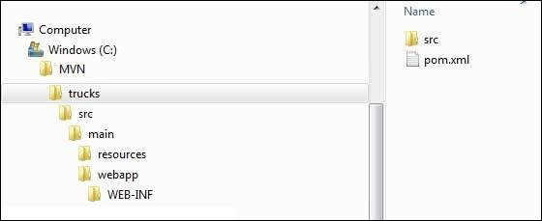
Maven - Web Application
To create a simple java web application, we will use maven-archetype-webapp plugin.
mvn archetype:generate
-DgroupId = com.companyname.automobile
-DartifactId = trucks
-DarchetypeArtifactId = maven-archetype-webapp
-DinteractiveMode = false

Slide 75
Sr.No. | Folder Structure & Description
1 | trucks contains src folder and pom.xml.
2 | src/main/webapp contains index.jsp and WEB-INF folder.
3 | src/main/webapp/WEB-INF contains web.xml
4 | src/main/resources it contains images/properties files.

Slide 77
變更中央倉庫到Google的鏡象倉庫以加速函式庫下載(修改 x:\maven\conf\settings.xml的設定 )
<mirrors>
<mirror>
<id>google-maven-central</id>
<name>Google Maven Central</name>
<url>https://maven-central.storage.googleapis.com</url>
<mirrorOf>central</mirrorOf>
</mirror>
</mirrors>

Slide 78
互動方式建立Project
mvn archetype:generate
下指令完成
mvn archetype:create -DgroupId=idv.kentyeh.software \
-DartifactId=firstmaven \
-DpackageName=idv.kentyeh.software \
-DarchetypeArtifactId:maven-archetype-quickstart \
-Dversion=1.0-SNAPSHOT

Slide 79
POM
<!--本Project識別-->
<groupId>idv.kentyeh.software</groupId>
<artifactId>firstmaven</artifactId>
<version>1.0-SNAPSHOT</version>
<packaging>jar</packaging>
<!--表示打包Project的型態,可能為Jar、war、ear或pom，若是使用了android 則為apk-->
<!--以下是給工具看的,主要是本Project的資訊-->
<name>第一個MavenProject</name>
<url>http://sites.google.com/site/gwtmemo</url>
<!--設定一些變數-->
<properties>
<project.build.sourceEncoding>UTF-8</project.build.sourceEncoding>
</properties>

Slide 80
<!--設定引用函式庫-->
<dependencies>
<dependency>
<groupId>junit</groupId>
<artifactId>junit</artifactId>
<version>4.12</version>
<scope>test</scope>
</dependency>
</dependencies>

Slide 81
Dependency scope
compile | 預設值，表示Project程式須要這個Library才能運作，所以會一併被打包
provided | 由系統提供，打包Project不要含進去，例如J2ee的Library，像是servlet-api，就是由App Server提供
runtime | 表示編譯時用不到，只有執行時會用到，所以發佈程式時須要一併打包，如GWT 的 gwt-servlet.jar
test | 只有在單元測試時會用到，發佈程式時並不會用到，所以不會被打包
system | 與provided相似，但是固定存在系統檔案,須以 systemPath 指定路徑

Slide 82
Maven Plugin
plugin是一種專供 Maven本身使用的Library，同一個plugin通常使用同一前置字，然後本身會帶有說明提供那些作業的自我解說檔(metadata)， 通常這個自我解說檔，也會定義每種作業隸屬於那種phase(作業階段)；
Maven 的指令可以串接
mvn clean package javadoc:javadoc exec:exec

Slide 83
要執行maven-javadoc-plugin這個Plugin的javadoc task時，完整的命令下法應該是
mvn org.apache.maven.plugins:maven-javadoc-plugin:2.10.1:Javadoc
Maven執行時，會去讀取每個plugin java的metadata， 而maven-javadoc-plugin的metadata標記為javadoc，所以才省略為 javadoc:Javadoc
mvn javadoc:javadoc

Slide 84
plugin的定義結構
<build>
<plugins>
<!--可定義多個plugin-->
<plugin>
<groupId>org.apache.maven.plugins</groupId><!--若是此值，則可省略-->
<artifactId>maven-compiler-plugin</artifactId>
<version>3.1</version>
<configuration>
...各種設定
</configuration>
</plugin>
<plugins>
<finalName>firstmvn</finalName>
...
<build>

Slide 85
Project變數
compiler Plugin，encoding會預設參考${project.build.sourceEncoding}這個變數， 所以我們在pom.xml的指定這個變數的值為"UTF-8"，所以在編譯程式時，編譯器就會知道程式使用的編碼。
<project.build.sourceEncoding>UTF-8</project.build.sourceEncoding>

Slide 86
預設變數
${basedir} | 表示包含pom.xml的目錄路徑
${version} | 等同${project.version}或${pom.version}，即程式的版本編號(maven通常建議不要直接使用${version})
${project.build.directory} | 就是target目錄，等同${pom.project.build.directory}
${project.build.outputDirectory} | 就是target/classes目錄
${project.name} 或 ${pom.name} | 就是pom.xml '<name'>所指定的名稱
${project.build.finalName} | Project的打包名稱
${env.M2_HOME} | maven安裝目錄
${java.home} | Java安裝目錄
${java的系統變數} | 與其它JVM所定義的變數

Slide 87
Maven pahse
Maven有三個LifeCycle，分別是 clean 、 default 與 site ，
clean周期負責Project的清理，
default周期負責Project的建置
site周期則是負責產生Project的文檔

Slide 88
常用的指令(goals)
mvn clean | 進行清理作業，通常是將${project.build.directory} 砍掉
mvn compile | 編譯程式
mvn test | 測試程式
mvn package | 打包程式
mvn install | 把Project打包後，放進本地repository
mvn jetty:run或是 mvn tomcat:run | 如果是webProject，直接上起來執行
mvn source:jar | 把source打包成一個jar檔

Slide 89
常用的指令(goals)
mvn javadoc:javadoc | 產生java api檔案
mvn javadoc:jar | 產生java api打包檔案
mvn exec:exec | 執行Project(需進行一些[設定])
mvn versions:display-dependency-updates | 檢查相依函式庫的版本更新狀況
mvn versions:use-latest-releases | 直接將pom.xml內的版本更新到最近一版釋出(會備分舊版的pom.xml)
mvn versions:display-plugin-updates | 檢查Plugin的更新狀況

Slide 90
常用的plugin build設定
Compile的設定
<build>
<plugins>
<plugin>
<groupId>org.apache.maven.plugins</groupId>
<artifactId>maven-compiler-plugin</artifactId>
<version>3.1</version>
<configuration>
<source>${maven.compiler.source}</source>
<target>${maven.compiler.target}</target>
<encoding>${project.build.sourceEncoding}</encoding>
</configuration>
</plugin>
</plugins>
</build>

Slide 91
打包時包含源碼
<build>
<resources>
<resource>
<directory>${basedir}/src/main/java</directory><!--資源檔存放路徑-->
<filtering>false</filtering><!--不置換資源檔內容,如果要的話見http://maven.apache.org/plugins/maven-resources-plugin/examples/filter.html-->
<includes>
<include>org/gwtwidgets/Stream.gwt.xml</include>
</includes>
</resource>
<resource>
<directory>${basedir}/src/main/java</directory>
<includes>
<include> **/client/*.java </include>
</includes>
</resource>
</resources>
</build>

Slide 92
建立可執行Jar
<build>
<plugins>
<plugin>
<groupId>org.apache.maven.plugins</groupId>
<artifactId>maven-jar-plugin</artifactId>
<version>2.4</version>
<configuration>
<archive>
<manifest>
<addClasspath>true</addClasspath>
<mainClass>完整類別名稱(有main方法的class)</mainClass>
</manifest>
</archive>
</configuration>
</plugin>
</plugins>
</build>

Slide 93
建立單一可執行Jar(把所有Library一起打成一包)
<build>
<plugins>
<plugin>
<groupId>org.apache.maven.plugins</groupId>
<artifactId>maven-assembly-plugin</artifactId>
<version>2.4</version>
<configuration>
<archive>
<manifest>
<mainClass>完整類別名稱(有main方法的class)</mainClass>
</manifest>
</archive>
<descriptorRefs>
<descriptorRef>jar-with-dependencies</descriptorRef>
</descriptorRefs>
</configuration>
</plugin>
</plugins>
</build>

Slide 94
直接執行程式
設定好後便可以以 "mvn exec:exec"執行程式
<build>
<plugins>
<plugin>
<groupId>org.codehaus.mojo</groupId>
<artifactId>exec-maven-plugin</artifactId>
<version>1.2.1</version>
<configuration>
<executable>java</executable>
<arguments>
<argument>-classpath</argument>
<classpath />
<argument>完整類別名稱(有main方法的class)</argument>
</arguments>
</configuration>
</plugin>
</plugins>
</build>

Slide 95
設定goal關聯到phase
設定將 exec:exec 關聯到 test 這個 phase，當我們執行 "mvn test" 時，就會先進行 compile然後再執行 "exec:exec"
<build>
<plugins>
<plugin>
<groupId>org.codehaus.mojo</groupId>
<artifactId>exec-maven-plugin</artifactId>
<version>1.2.1</version>
<executions>
<execution><!--設定Goal的執行方式-->
<phase>test</phase><!--將以下Goals關聯到 test Phase-->
<goals>
<goal>exec</goal> <!--要設定的goal-->
</goals>
</execution>
</executions>
<configuration>
<executable>java</executable>
<arguments>
<argument>-classpath</argument>
<classpath />
<argument>完整類別名稱(有main方法的class)</argument>
</arguments>
</configuration>
</plugin>
</plugins>
</build>

Slide 96
建立單一可執行Jar
之前建立單一可執行Jar，並不會把Jar裡面的META-INF一起包進去，可是像Spring的把Schma等相關資料都放在META-INFO內， 所以必須使用其它的plugin一起將這些資料包進去，並設定關聯到"package" phase

Slide 97
<project ...>
<build>
<plugins>
<plugin>
<groupId>org.apache.maven.plugins</groupId>
<artifactId>maven-shade-plugin</artifactId>
<version>2.1</version>
<executions>
<execution>
<phase>package</phase>
<goals>
<goal>shade</goal>
</goals>
<configuration>
<artifactSet>
<excludes><!--用 mvn dependency:analyze 指令檢視並移除一些不需要的函式庫-->
<exclude>org.apache.logging.log4j:log4j-1.2-api:jar:</exclude>
<exclude>org.apache.logging.log4j:log4j-jcl:jar:</exclude>
<exclude>org.apache.logging.log4j:log4j-slf4j-impl:jar:</exclude>
<exclude>org.springframework:spring-context-support:jar:</exclude>
</excludes>
</artifactSet>

Slide 98
<transformers>
<transformer implementation="org.apache.maven.plugins.shade.resource.ManifestResourceTransformer">
<mainClass>完整類別名稱</mainClass>
</transformer>
<transformer implementation="org.apache.maven.plugins.shade.resource.AppendingTransformer">
<resource>META-INF/spring.handlers</resource>
</transformer>
<transformer implementation="org.apache.maven.plugins.shade.resource.AppendingTransformer">
<resource>META-INF/spring.schemas</resource>
</transformer>
</transformers>
</configuration>
</execution>
</executions>
</plugin>
</plugins>
</build>
</project>

Slide 99
系統變數的問題
Tomcat有一個預設的系統變數${catalina.home}可指到Tomcat所在的目錄，當我們進行單元測試時，開發環境下根本不認識這兩個變數，所以我們必須設定這個變數。
<build>
<plugins>
<plugin>
<groupId>org.apache.maven.plugins</groupId>
<artifactId>maven-surefire-plugin</artifactId><!--因為是測試時發生，所以設定這個Plugin-->
<version>2.16</version>
<configuration>
<systemProperties>
<property>
<name>catalina.home</name><!--要設定系統變數名稱-->
<value>${project.build.directory}</value><!--把這個變數指到輸出目錄-->
</property>
</systemProperties>
<suiteXmlFiles>
<suiteXmlFile>src/test/resources/testng.xml</suiteXmlFile><!--因為我是用testNG，所以指定testNG的設定檔-->
</suiteXmlFiles>
</configuration>
</plugin>
</plugins>
</build>

Slide 100
資源檔的變數替代
系統中常常必須要使用一些設定檔例如 .properties 或是 .xml結尾的檔案，常常我們會把一些設定放進裡面，例如資料庫的connection string， 以便在開發時期使用測試的資料庫而執行時期使用正式的資料庫。
我們須要能夠在設定檔中放入一些變數，而這些變數的值要能夠在外部(如執行時的參數或是設定在pom.xml內)決定其值：
<build>
<resources>
<resource>
<directory>${basedir}/src/main/resources</directory>
<filtering>true</filtering>
</resource>
</resources>
<testResources>
<testResource>
<directory>${basedir}/src/test/resources</directory>
<filtering>true</filtering>
</testResource>
</testResources>
</build>
directory 是資源檔的目錄所在，filtering設為true表示裡面的檔案要替換

Slide 101
常用的Log4j2.xml裡的設定，裡面的變數(${project.artifactId})就會被置換為專案名稱
<Configuration status="warn" name="${project.artifactId}" verbose="false" monitorInterval="30">
<Appenders>
<Console name="console">
<PatternLayout pattern="%d{HH:mm:ss.SSS} [%t] %highlight`{`%-5level`} %class{1.}.%M(%L) - %highlight{%msg}%n%ex{full}%n" />
</Console>
<RollingRandomAccessFile name="${project.artifactId}-Rolling" fileName="${sys:catalina.home}/logs/${project.artifactId}.log"
filePattern="${sys:catalina.home}/logs/${project.artifactId}-%d{MM-dd-yyyy}-%i.log.gz">
<PatternLayout>
<pattern>%d %p [%t] %C{1.}.%M(%L) %m%n%ex{full}%n</pattern>
</PatternLayout>
<Policies>
<TimeBasedTriggeringPolicy />
<SizeBasedTriggeringPolicy size="250 MB" />
</Policies>
</RollingRandomAccessFile>
<Async name="Async-${project.artifactId}-Rolling">
<AppenderRef ref="${project.artifactId}-Rolling"/>
</Async>
</Appenders>
<Loggers>
<Logger name="com.spring" level="INFO" additivity="false">
<AppenderRef ref="console" />
<AppenderRef ref="${project.artifactId}-Rolling" />
</Logger>
<Root level="info">
<AppenderRef ref="console" />
<AppenderRef ref="${project.artifactId}-Rolling" />
</Root>
</Loggers>
</Configuration>

Slide 102
組態管理
<project ...>
<modelVersion>4.0.0</modelVersion>
<groupId>您的單位或組識</groupId>
<artifactId>專案名稱</artifactId>
<version>版本</version>
<packaging>pom</packaging>
<scm>
<url>http://yourSvnHost:port/.../</url><!--可直接檢視Repository的網址-->
<connection>scm:git:git@yourSvnHost/.../</connection><!--git網址，如果是svn換成scm:svn:http://yourSvnHost:port/.../-->
<developerConnection>scm:git:git@yourSvnHost/.../</developerConnection><!--開發人員所用的git網址，如果是svn換成scm:svn:http://yourSvnHost:port/.../-->
</scm>

Slide 103
<build>
<plugins>
<plugin>
<groupId>org.apache.maven.plugins</groupId>
<artifactId>maven-scm-plugin</artifactId>
<version>1.8.1</version>
<!-- Checkout之後要執行的Goal -->
<configuration>
<goals>package</goals><!--給scm:bootstrap goal使用，checkout後立即執行 package goal-->
<connectionType>developerConnection</connectionType><!--預設是connection，這裡換成開發人員-->
<!--username>svn帳號</username-->
<!--password>svn密碼</password-->
</configuration>
</plugin>
</plugins>
</build>
</project>

Slide 104
執行 "mvn scm:bootstrap" 您可以發現程式不但下載，且立即執行打包作業
scm通常有帳號/密碼，設定在settings.xml
<servers>
<server>
<id>yourRepoHost:port</id>
<username>svn帳號</username>
<password>svn密碼</password>
</server>
...
</servers>

Slide 105
版本衝突管理
"mvn dependency:tree" 來找出dependency的引用關系
讓spring-security-core排除引用 org.springframework.core 3.0.3版，設定如下：
<dependencies>
<dependency>
<groupId>org.springframework</groupId>
<artifactId>org.springframework.core</artifactId>
<version>3.0.5.RELEASE</version>
</dependency>
<dependency>
<groupId>org.springframework</groupId>
<artifactId>spring-security-core</artifactId>
<version>3.0.5.RELEASE</version>
<exclusions>
<exclusion>
<groupId>org.springframework</groupId>
<artifactId>org.springframework.core</artifactId>
</exclusion>
</exclusions>
</dependency>
<dependencies>

Slide 106
最新版本檢查
"mvn versions:display-dependency-updates" 檢查使用的函式庫有那些更新的版本
"mvn versions:display-plugin-updates" 檢查使用的Plugin有那些更新的版本

Slide 109
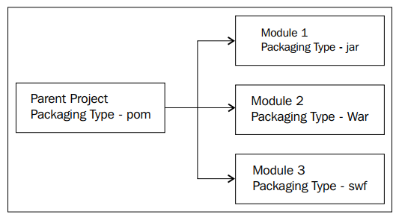
Project modularization

Slide 110
parent project
set the value of packaging to pom
navigate to the parent POM directory, and run the following command: $ mvn archetype:generate
<?xml version="1.0" encoding="UTF-8"?> <project xmlns="http://maven.apache.org/POM/4.0.0" xmlns:xsi="http://www.w3.org/2001/XMLSchema-instance" xsi:schemaLocation="http://maven.apache.org/POM/4.0.0 http://maven.apache.org/xsd/maven-4.0.0.xsd"> <modelVersion>4.0.0</modelVersion> <groupId>net.srirangan.packt.maven</groupId> <artifactId>TestModularApp</artifactId> <version>1.0-SNAPSHOT</version> <packaging>pom</packaging> <name>MyLargeModularApp</name> </project>

Slide 111
After project generation, the POM file of the original parent project will be modified
<?xml version="1.0" encoding="UTF-8"?>
<project xmlns="http://maven.apache.org/POM/4.0.0" xmlns:xsi="http://www.w3.org/2001/XMLSchema-instance" xsi:schemaLocation="http://maven.apache.org/POM/4.0.0 http://maven.apache.org/xsd/maven-4.0.0.xsd">
<modelVersion>4.0.0</modelVersion>
<groupId>net.srirangan.packt.maven</groupId>
<artifactId>TestModularApp</artifactId>
<version>1.0-SNAPSHOT</version>
<packaging>pom</packaging>
<name>MyLargeModularApp</name>
<modules>
<module>test-child</module>
</modules>
</project>

Slide 112
the child project's pom file
<?xml version="1.0" encoding="UTF-8"?>
<project xmlns="http://maven.apache.org/POM/4.0.0" xmlns:xsi="http://www.w3.org/2001/XMLSchema-instance" xsi:schemaLocation="http://maven.apache.org/POM/4.0.0 http://maven.apache.org/xsd/maven-4.0.0.xsd">
<modelVersion>4.0.0</modelVersion>
<parent>
<artifactId>TestModularApp</artifactId>
<groupId>net.srirangan.packt.maven</groupId>
<version>1.0-SNAPSHOT</version>
</parent>
<groupId>cht.hioss.test</groupId>
<artifactId>test-child</artifactId>
<version>1.0-SNAPSHOT</version>
………………..

Slide 113
executing build phase on the parent project automatically gets executed for all its child projects in the correct order.
but executing build phase on the child project only gets executed for the child project.

Slide 114
Dependency management
Maven dependencies have six possible scopes:
Compile: This is the default scope. Compile dependencies are available in the classpaths.
Provided: This scope assumes that the JDK or the environment provides dependencies at runtime.
Runtime: Dependencies that are required at runtime and are specifed in the runtime classpaths.
Test: Dependencies required for test compilation and execution.
System: Dependency is always available, but the JAR is provided nonetheless.
Import: Imports dependencies specifed in POM included via the <dependencyManagement/> element.

Slide 115
According to http://maven.apache.org/plugins/maven-dependency-plugin/:
"The dependency plugin provides the capability to manipulate artifacts. It can copy and/or unpack artifacts from local or remote repositories to a specifed location.
$ mvn dependency:analyze
Analyzes dependencies (used, unused, declared, undeclared)
$ mvn dependency:analyze-duplicate
Determines duplicate dependencies
$ mvn dependency:resolve
Resolves all dependencies
$ mvn dependency:resolve-plugins
Resolves all plugins
$ mvn dependency:tree
Displays dependency trees

Slide 116
In Multi-modular projects, dependencies can be defned in the parent POM fles and can be subsequently inherited by child POM fles as and when required.
The parent POM would contain the complete defnition of the dependency:
<dependencyManagement> <dependencies> <dependency> <groupId>mysql</groupId> <artifactId>mysql-connector-java</artifactId> <version>5.1.2</version> </dependency> <dependencies> </dependencyManagement>

Slide 117
All child modules that require MySQL would only include a stub dependency defnition:
There will be no version conﬂicts between multiple child modules having the same dependencies.
<dependency> <groupId>mysql</groupId> <artifactId>mysql-connector-java</artifactId> </dependency>

Slide 118
Source code quality checks
The Apache Maven PMD plugin automatically runs the PMD code analysis tool on the source code and generates a site report with results.
In a typical confguration, the build fails if PMD detects quality issues in the source.
This plugin introduces four goals:
pmd:pmd creates a PMD site report based on the rulesets and confguration set in the plugin
pmd:cpd generates a report for PMD's Copy/Paste Detector (CPD) tool
pmd:check verifes that the PMD report is empty and fails the build if it is not
pmd:cpd-check verifes that the CPD report is empty and fails the build if it is not

Slide 119
The PMD plugin needs to be integrated into your project. It can be added to the project POM fle under the reporting element:
<reporting> <plugins> <plugin> <groupId>org.apache.maven.plugins</groupId> <artifactId>maven-pmd-plugin</artifactId> <version>2.5</version> </plugin> </plugins> </reporting>

Slide 120
The PMD checks can be integrated with Maven's default build lifecycle, as shown in the following code:
<build> <plugins> <plugin> <groupId>org.apache.maven.plugins</groupId> <artifactId>maven-pmd-plugin</artifactId> <version>2.5</version> <executions> <execution> <goals> <goal>check</goal> <goal>cpd-check</goal> </goals> </execution> </executions> </plugin> </plugins> </build>

Slide 121
Embedding the Apache Maven PMD plugin eliminates the need to otherwise install or confgure PMD as a third-party application.

Slide 122
Deployment automation
The Maven Deploy Plugin is used to add artifact(s) to a remote repository during the deploy phase of the build lifecycle.
deploy:deploy: To deploy a project and all its artifacts
deploy:deploy-file: To deploy a single artifact file
Deployment to a repository means not only to copy the artifacts to a folder but to updatemetadata regarding the artifacts as well. It requires:
Target repository: Its location, the protocol for access (FTP, SCP, SFTP), and user-specifc account information are required.
Target artifacts: Artifact groupId, artifactId, version, packaging, and classifier information are required.
Deployer method to actually perform the deployment

Slide 123
you need to specify a server defnition in your settings.xml
<server> <id>srirangan.repository</id> <username>srirangan</username> <password>myTopSecretPassword</password> </server>

Slide 124
The project POM must include a valid <distributionManagement/> element, which provides a <repository/> element defning the remote repository location for the artifact.
<distributionManagement> <repository> <id>srirangan.repository</id> <name>MyPrivateRepository</name> <url>...</url> </repository> </distributionManagement>

Slide 125
The <distributionManagement/> element is inherited allowing for registry of this information in the parent POM fle to make them available to all sub-modules.
The actual deployment takes place based on the protocol defned in the repository with the commonly used protocols being FTP and SSH.
wagon-ftp and wagon-ssh-external are providers for these two protocols.

Slide 126
If the remote repository is accessible through FTP, then the project POM build elements need to include the specifcation of the wagon-ftp extension.
<distributionManagement> <repository> <id>sri-ftp-repository</id> <url>ftp://...</url> </repository> </distributionManagement> <build> <extensions> <extension> <groupId>org.apache.maven.wagon</groupId> <artifactId>wagon-ftp</artifactId> <version>1.0-beta-6</version> </extension> </extensions> </build>

Slide 127
For deployment using SSH, note the changes in the extension artifactId and the URL.
<distributionManagement> <repository> <id>sri-ssh-repository</id> <url>scpexe://....</url> </repository> </distributionManagement> <build> <extensions> <extension> <groupId>org.apache.maven.wagon</groupId> <artifactId>wagon-ssh-external</artifactId> <version>1.0-beta-6</version> </extension> </extensions> </build>

Slide 129
Creating centralized remote repositories
Downlaod
https://www.sonatype.com/download-oss-sonatype
解壓縮後，會出現兩個目錄：
Installation directory
nexus-xxxx：nexus服務目錄，包括日誌，配置、啟動、應用。
contains the Nexus Repository Manager application and all the required additional components such as Java libraries and configuration files
Data directory
sonatype-work：nexux儲存目錄，下載上傳的各個包存貯在這裡。
This directory contains all the repositories, components and other data that are stored and managed by the repository manager.
The default location of the data directory is ../sonatype-work/nexus3 relative to the installation directory.

Slide 130
To start the repository manager from application directory in the bin folder on a Unix-like platform like Linux use:
./nexus run
The equivalent invocation on Windows requires a / in front of the run and any other commands.
nexus.exe /run
In order to shut down the repository manager running via the run command, you have to press CTRL-C
The nexus script can be used to manage the repository manager as a background application on OSX and Unix with the start, stop, restart, force-reload and status commands.

Slide 131
Accessing the User Interface
http://localhost:8081/
username is admin
the initial password can be found in an admin.password file in the $data-dir directory.

Slide 132
我們可以看到倉庫型別有四種：
hosted(宿主倉庫)：用來部署自己,第三方或者公共倉庫的構件
proxy(代理倉庫)：代理遠端倉庫
virtual(虛擬倉庫)：預設提供了一個Central M1虛擬倉庫，用來將maven 2適配為maven 1
group(倉庫組)：統一管理多個倉庫

Slide 133
點選左側Security—》Users，設定使用者及許可權。 我們可以看到有三個預設的賬號：
Admin(管理員賬號)：Nexus管理員許可權，最高許可權，什麼操作都可以做。
Deployment(部署賬號)：Nexus部署許可權，以及所有倉庫的CRUDV操作許可權。
Anonymous(匿名賬號)：Nexus匿名許可權，以及所有倉庫只讀許可權。
我們正常訪問倉庫的時候，是不需要這三個賬戶的，一般我們會把Deployment賬戶暴漏出來，方便開發或運維部署專案使用，我們可以直接使用該部署賬號，亦可以新建立一個自己的賬號資訊，通過Add Role Management來控制該賬號的許可權。

Slide 136
Available Plugins
https://maven.apache.org/plugins/index.html
lugin | Type* | Version | Release Date | Description
Core plugins |  |  |  | Plugins corresponding to default core phases (ie. clean, compile). They may have multiple goals as well.
clean | B | 3.1.0 | 2018-04-14 | Clean up after the build.
compiler | B | 3.8.1 | 2019-04-28 | Compiles Java sources.
deploy | B | 3.0.0-M1 | 2018-09-23 | Deploy the built artifact to the remote repository.
failsafe | B | 3.0.0-M4 | 2019-11-17 | Run the JUnit integration tests in an isolated classloader.
install | B | 3.0.0-M1 | 2018-09-23 | Install the built artifact into the local repository.
resources | B | 3.1.0 | 2018-04-23 | Copy the resources to the output directory for including in the JAR.
site | B | 3.9.0 | 2020-03-10 | Generate a site for the current project.
surefire | B | 3.0.0-M4 | 2019-11-17 | Run the JUnit unit tests in an isolated classloader.
verifier | B | 1.1 | 2015-04-14 | Useful for integration tests - verifies the existence of certain conditions.

Slide 137
lugin | Type* | Version | Release Date | Description
Packaging types/tools |  |  |  | These plugins relate to packaging respective artifact types.
ear | B | 3.0.2 | 2019-11-11 | Generate an EAR from the current project.
ejb | B | 3.0.1 | 2018-05-03 | Build an EJB (and optional client) from the current project.
jar | B | 3.2.0 | 2019-11-03 | Build a JAR from the current project.
rar | B | 2.4 | 2014-09-08 | Build a RAR from the current project.
war | B | 3.2.3 | 2019-05-23 | Build a WAR from the current project.
app-client/acr | B | 3.1.0 | 2018-06-19 | Build a JavaEE application client from the current project.
shade | B | 3.2.3 | 2020-04-13 | Build an Uber-JAR from the current project, including dependencies.
source | B | 3.2.1 | 2019-12-21 | Build a source-JAR from the current project.
jlink | B | 3.0.0-alpha-1 | 2017-09-09 | Build Java Run Time Image.
jmod | B | 3.0.0-alpha-1 | 2017-09-17 | Build Java JMod files.
Reporting plugins |  |  |  | Plugins which generate reports, are configured as reports in the POM and run under the site generation lifecycle.
changelog | R | 2.3 | 2014-06-24 | Generate a list of recent changes from your SCM.
changes | B+R | 2.12.1 | 2016-11-01 | Generate a report from an issue tracker or a change document.
checkstyle | B+R | 3.1.1 | 2020-02-08 | Generate a Checkstyle report.
doap | B | 1.2 | 2015-03-17 | Generate a Description of a Project (DOAP) file from a POM.

Slide 138
lugin | Type* | Version | Release Date | Description
docck | B | 1.1 | 2015-04-03 | Documentation checker plugin.
javadoc | B+R | 3.2.0 | 2020-03-16 | Generate Javadoc for the project.
jdeps | B | 3.1.2 | 2019-06-12 | Run JDK's JDeps tool on the project.
jxr | R | 3.0.0 | 2018-09-25 | Generate a source cross reference.
linkcheck | R | 1.2 | 2014-10-08 | Generate a Linkcheck report of your project's documentation.
pmd | B+R | 3.13.0 | 2020-01-25 | Generate a PMD report.
project-info-reports | R | 3.0.0 | 2018-06-23 | Generate standard project reports.
surefire-report | R | 3.0.0-M4 | 2019-11-17 | Generate a report based on the results of unit tests.
Tools |  |  |  | These are miscellaneous tools available through Maven by default.
antrun | B | 3.0.0 | 2020-04-15 | Run a set of ant tasks from a phase of the build.
archetype | B | 3.1.2 | 2019-08-22 | Generate a skeleton project structure from an archetype.
assembly | B | 3.2.0 | 2019-11-03 | Build an assembly (distribution) of sources and/or binaries.
dependency | B+R | 3.1.2 | 2020-03-07 | Dependency manipulation (copy, unpack) and analysis.
enforcer | B | 3.0.0-M3 | 2019-11-23 | Environmental constraint checking (Maven Version, JDK etc), User Custom Rule Execution.
gpg | B | 1.6 | 2015-01-19 | Create signatures for the artifacts and poms.

Slide 139
lugin | Type* | Version | Release Date | Description
help | B | 3.2.0 | 2019-04-16 | Get information about the working environment for the project.
invoker | B+R | 3.2.1 | 2019-09-13 | Run a set of Maven projects and verify the output.
jarsigner | B | 3.0.0 | 2018-11-06 | Signs or verifies project artifacts.
jdeprscan | B | 3.0.0-alpha-1 | 2017-11-15 | Run JDK's JDeprScan tool on the project.
patch | B | 1.2 | 2015-03-09 | Use the gnu patch tool to apply patch files to source code.
pdf | B | 1.4 | 2017-12-28 | Generate a PDF version of your project's documentation.
plugin | B+R | 3.6.0 | 2018-11-01 | Create a Maven plugin descriptor for any mojos found in the source tree, to include in the JAR.
release | B | 3.0.0-M1 | 2019-12-08 | Release the current project - updating the POM and tagging in the SCM.
remote-resources | B | 1.7.0 | 2020-01-21 | Copy remote resources to the output directory for inclusion in the artifact.
scm | B | 1.11.2 | 2019-03-21 | Execute SCM commands for the current project.
scm-publish | B | 3.0.0 | 2018-01-29 | Publish your Maven website to a scm location.
stage | B | 1.0 | 2015-03-03 | Assists with release staging and promotion.
toolchains | B | 3.0.0 | 2019-06-16 | Allows to share configuration across plugins.

Slide 141
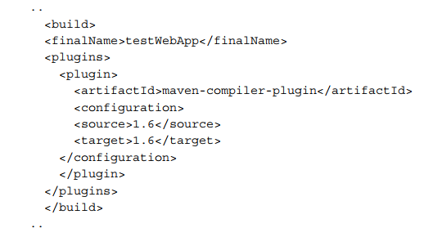
5 Java Developmentwith Maven
Building a web application
mvn archetype:generate -DarchetypeArtifactId=maven-archetypewebapp -DartifactId=testWebApp -DgroupId=net.srirangan.packt.maven -Dversion=1.0-SNAPSHOT -Dpackage=net.srirangan.packt.maven
add a build plugin to compile the project with JDK 1.6 in POM

Slide 142
You can run the commands to compile and test the project. $ mvn compile $ mvn test $ mvn install
In the target folder, you will fnd a WAR fle named testWebApp.war.

Slide 143
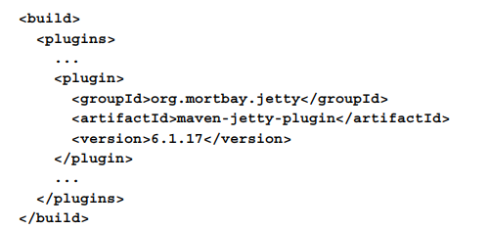
Running a web application
Jetty is a pure Java-based HTTP server and servlet container (application server). Jetty plugin

Slide 144
$ mvn jetty:run
This goal doesn't require the project to be assembled as a WAR fle and will deploy the web application directly from the project.
$ mvn jetty:run-exploded
This goal is used to deploy the exploded WAR fle assembled from the project.
$ mvn jetty:run-war
This goal is used to deploy the WAR fle assembled from the project

Slide 145
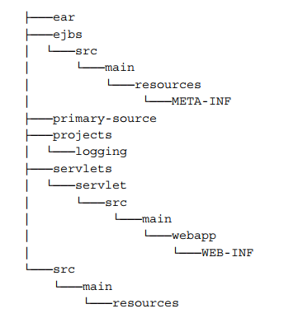
Enterprise Java development with Maven
The EAR plugin supports the following artifacts:ejb, war, jar, ejb-client, rar, ejb3, par, sar, wsr, har
$mvn archetype:generate -DarchetypeArtifactId=maven-archetype-j2ee-simple

Slide 146
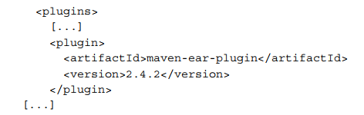
The confguration of the EAR plugin
mvn ear:ear
Builds the Enterprise Archive files
mvn ear:generate-application-xml
Generates EAR deployment description fles
mvn ear:help
Displays help information
mvn ear:generate-application-xml

Slide 147
Creating a Maven plugin using Java
we will create a MOJO (Maven plain Old Java Object), build it, include it in another project, and execute it from the command line.
Start your console and execute the following command:
$ mvn archetype:generate -DgroupId=net.srirangan.packt.maven -DartifactId=maven-plug101-plugin -DarchetypeGroupId=org.apache. maven.archetypes -DarchetypeArtifactId=maven-archetype-mojo
using the maven-archetype-mojo archetype as your project template.
Now build and install this project in your local repository with the following command:
$ mvn clean install

Slide 148
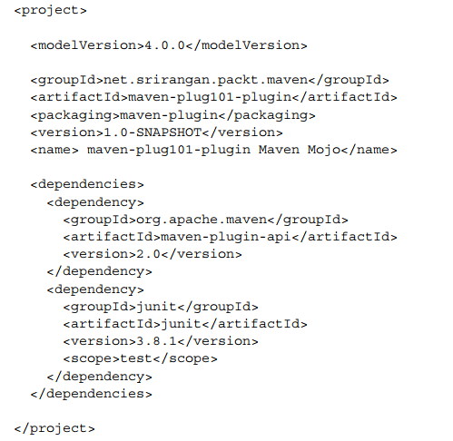
POM

Slide 149
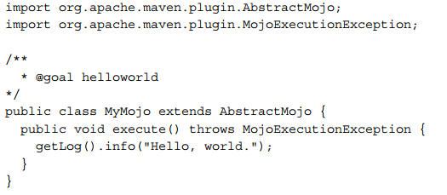
Open the MyMojo.java fle for editing.
The MyMojo class extends org.apache.maven.plugin.AbstractMojo.
You are required to implement the execute() method.
specifed a custom goal
The @goal annotation is used inside a comment which is different from typical annotation usage in Java 6.

Slide 150
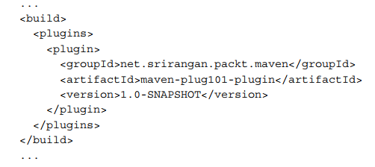
modify the POM fle (pom.xml) to include this plugin:
execute the plugin using the fully qualifed goal command:
$ mvn net.srirangan.packt.maven:maven-plug101-plugin:1.0- SNAPSHOT:helloworld

Slide 151
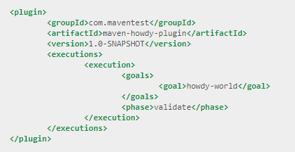
The following fragment of a pom.xml file shows how to attach the "howdy-world" goal to the "validate" lifecycle phase.

Slide 153
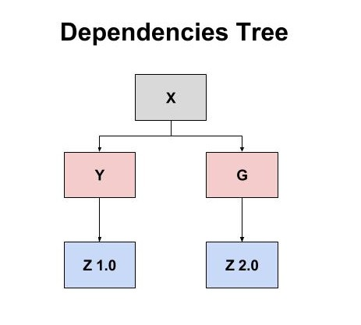
Solving Dependency Conflicts in Maven
how the dependency mechanism works.
First and foremost, the library’s version whose node is nearest to the root (project X) in the dependency tree will be used.
if there are several versions of the same library on the same level in the tree, the first library version found is used. This means that the choice of library versions depends on the dependency order inside the POM file, where those dependencies declared first will be chosen first.

Slide 154
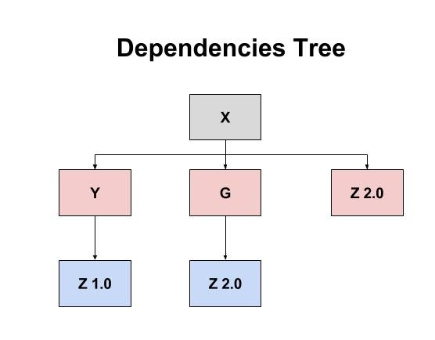
How to Solve the Conflict
The first and easiest solution is to import library G before library Y inside X's POM file;
However, a neater solution would be to import the last version of Z (2.0) as a direct dependency of X
if library Z supports backward compatibility (as library Y uses v1.0 of Z).
Tests are needed to increase reliability in this case

Slide 155
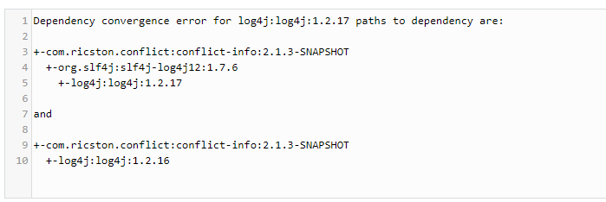
How Can I Discover Conflicts Faster?
add enforcer plugin in pom.xml
<plugins>
<plugin>
<groupId>org.apache.maven.plugins</groupId>
<artifactId>maven-enforcer-plugin</artifactId>
<version>1.4.1</version>
<configuration>
<rules><dependencyConvergence/></rules>
</configuration>
</plugin>
</plugins>
mvn enforcer:enforce

Slide 157
Reference
Mave教學 | Maven 初學者中文教程
https://kentyeh.github.io/mavenStartup/index.html
Mave教學
http://tw.gitbook.net/maven/index.html
Maven tutorial
https://www.tutorialspoint.com/maven/index.htm
Solving Dependency Conflicts in Maven
https://dzone.com/articles/solving-dependency-conflicts-in-maven

